Slide 1
Return to school Level 3 plus
Information current as at 7 October 2021
Developed in partnership with NSW Health
Notes:
Return to school intro slide
ACTION: Insert your school logo in the box to personalise the slideshow.

Slide 2
Acknowledgement of Country
I acknowledge that I am hosting this virtual assembly from the lands of the Wonnaruah, Darkinjung and Awabakal people. I also acknowledge the Ongoing Custodians of the various lands on which you are all calling in from today and the Aboriginal and Torres Strait Islander people participating in this assembly and throughout our school community.
Notes:
Acknowledgment of Country
ACTION: Insert name of the traditional custodians of the lands in which your school/community is located in the text on the slide.

Slide 3
What we'll cover in this session
- Key dates
COVID-safe practices at our school
Vaccinations
Preschool and out of school hours care
Where to find out more
Questions and answers
Notes:
Return to school in Term 4
Note: This is an introductory slide for you to welcome the community and give an overview of the contents of this virtual assembly.
Note: on many of the slides in this virtual assembly PPT you will see generic text relevant to all schools followed by red text in brackets for you to include tailored information relevant to your school community. On this page, for example, you can see red text reminding you to delete sections if not applicable to your school and to adapt the content as you see appropriate.

Slide 4
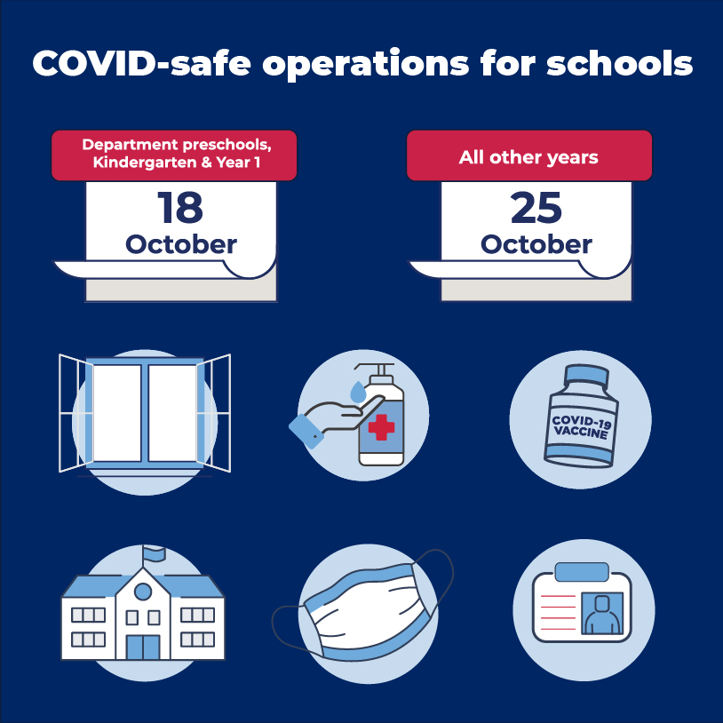
What you need to know about our return to school in Term 4
We’re excited about our return to face-to-face learning and welcoming students and staff back onsite where we know the best learning happens. This is a short summary of what our parents and students can expect.
There will be many updates sent out this week with more details on what the return to face-to face schooling will look like for the students of Cessnock East Public School.
Notes:
What you need to know about our return to school in Term 4
Talking points: The department’s COVID-safe return to school plan is approved by NSW Health and includes layers of protection to support the health and wellbeing of our students and staff. These practices include vaccinations, mask wearing, reduced mingling of student groups and staff, ventilation in classrooms and continued good hygiene and cleaning.

Slide 5
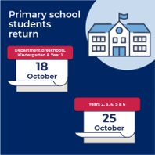
Key dates for our staged return
While we know there is excitement about the return to school it’s important that we stick to the staged return to give us time to be ready to welcome back students onsite. Students will return to face-to-face learning in the following order
from 18 October – department preschools, Kindergarten, Year 1
from 25 October – all remaining year groups
Notes:
Key dates for our staged return
Reminder: Don't forget to remind your community that there are just two dates for the staged return to school, replacing the three dates previously outlined. Dates are: 18 Oct: Preschool, Kindergarten and Year 1 and 25 October: All other school years.

Slide 6
Vaccinations
All staff required on site supporting the return to school will need to be fully vaccinated from 18 October. Then from 8 November all staff, contractors, volunteers and students on student placement on a school site will need to be fully vaccinated, including Outside of School Hours Care staff.
We are encouraging our school community to take up a vaccine as soon as possible.
Notes:
Vaccinations
ACTION: Replace red text with school-relevant information about vaccinations, e.g. Where you have canteens or uniform shops those people will need to be fully vaccinated. We are encouraging our school community to take up a vaccine as soon as possible xx, vaccines are available for eligible students and we encourage them to get vaccinated before returning to school, etc.

Slide 7
Keeping student groups together
As we return to school students will be kept in their cohorts to minimise opportunities for transmission of COVID-19 and to enable effective contact tracing and containment. This means minimising interaction between students on school grounds and keeping cohorts together where possible.
Cessnock East Public School will operate in Stage groups. This means that Kindergarten – KR and KS - will stay as one in the Early Stage 1 group. 1P, 1/2W and 2S will form the Stage 1 group. 3H, 3/4G and 4W will form the Stage 2 group. 4/5B, 5/6M and 6S will form the Stage 3 group.
Each Stage group will be allocated a different section of the playground to use at break times for the school week. Recess and lunch breaks will be staggered. Years 3-6 will have recess at 10:40am and their lunch time will start at 12:15pm. K-2 will have recess at the usual time of 11am and lunch at the usual time of 1pm.
We will return to staggered finish times for students from Monday 18th October 2021. Students will leave the school in their house groups so that families are able to collect their children at the one time. If you are unsure which house group your child is in, please check with their teacher, or call the school on 49901549.
Shakespeare will leave from Gate 5 and Newman will leave from Gate 4 at 2:55pm. This will give parents time to leave before the next group of students leave the school.
Drinkwater will leave from Gate 5 and Dodds will leave from Gate 4 at 3pm.
Students who are catching a bus, walking or riding home will leave the school at 3pm.
Notes:
Keeping student groups together
ACTION: Replace red text with school-relevant information about managing cohorting. Examples might include staggered recess and lunch breaks, staggered start and finish times. Draw from your reflection tool.

Slide 8
Mask wearing for students and staff
Masks are required to be worn on school site by staff indoors and outdoors and are strongly recommended for students indoors and outdoors unless exercising or eating.
You are welcome to send your child to school with a mask to wear, but please make sure your child’s name is written clearly on the outside of the mask. It is also very important to have a conversation with your child about only wearing his/her own mask.
The school does have a supply of student masks. If you would like one for your child, please call the school office on 49901549 and we will organise this for you.
Notes:
Masks
ACTION: Adjust for primary or high school setting (remove red text).
High schools: Masks or face covering to be worn at all times in all indoor and outdoor areas at school by
- all staff
- all student in Year 7 and above (except when eating or exercising).
Primary schools: Masks or face coverings to be worn at all times indoors and outdoors by all staff. Masks or face coverings are strongly recommended from primary students both indoors and outdoors (expect when eating or exercising).
Primary and high schools: Masks or face coverings to be worn for all travel on public transport for people 13 years and older.

Slide 9
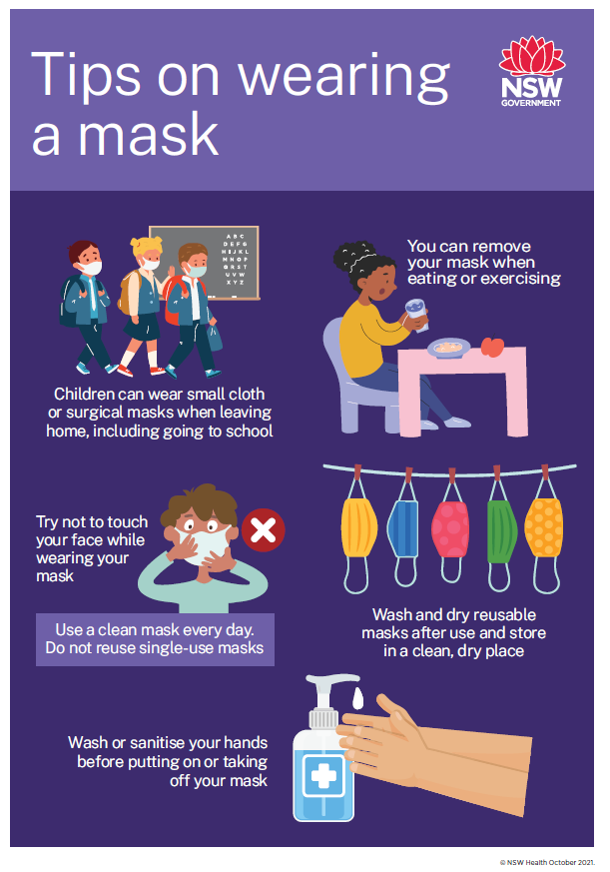
Fitting a mask on a younger child
Please send your child with a mask and a spare in their bag. We'll have some on site too.
We have a graphic from NSW Health on how to fit a mask properly – please have this conversation with your child.
While masks are not required in the Public Health Order for our primary students they are strongly recommended by NSW Health and the department has taken the decision that they are required as an important layer of protection for our staff – particularly while younger students are not yet vaccinated.
There are some exemptions around mask wearing – eating and exercising being the key times. Please have a look at the NSW Government website for the full list of exemptions. https://www.nsw.gov.au/covid-19/rules/changes/face-mask-rules
Notes:
Fitting a mask to younger children
Note: Remove this page if not relevant to your school setting.

Slide 10
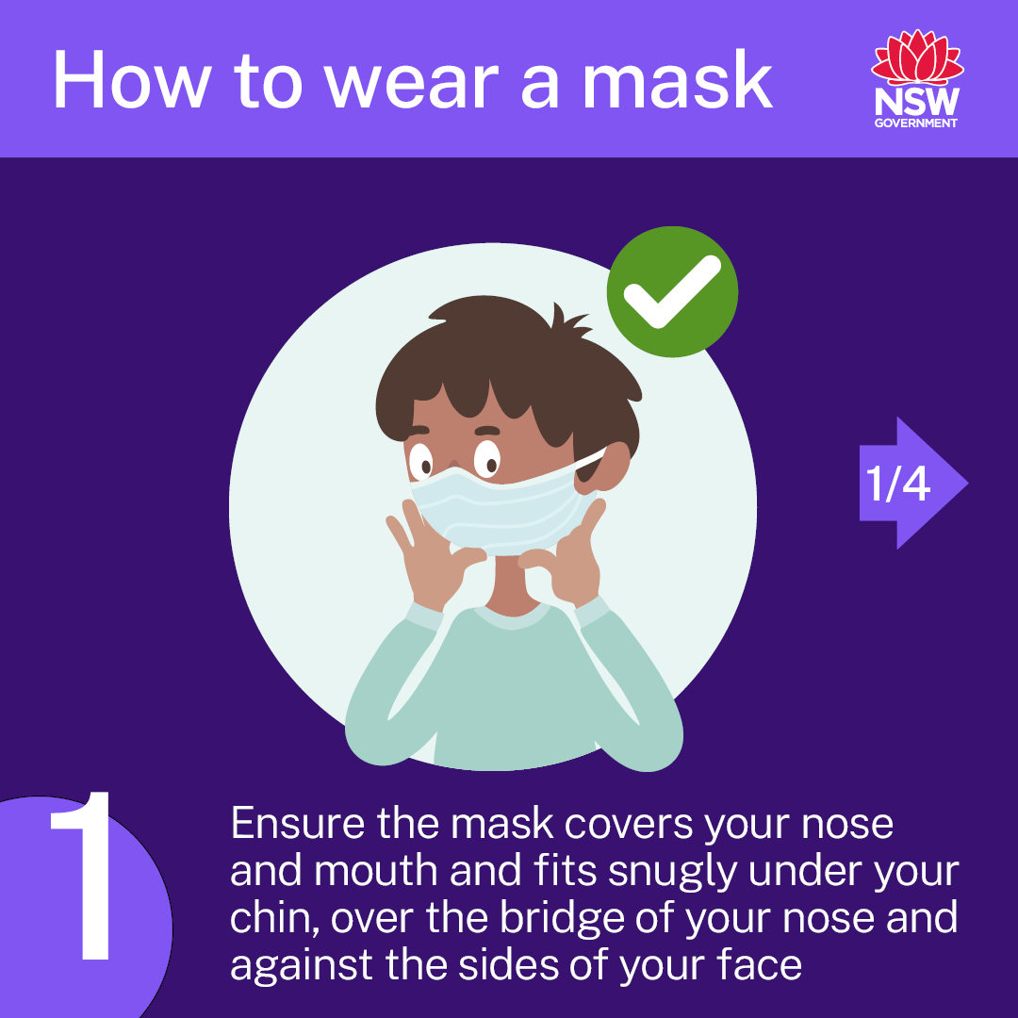
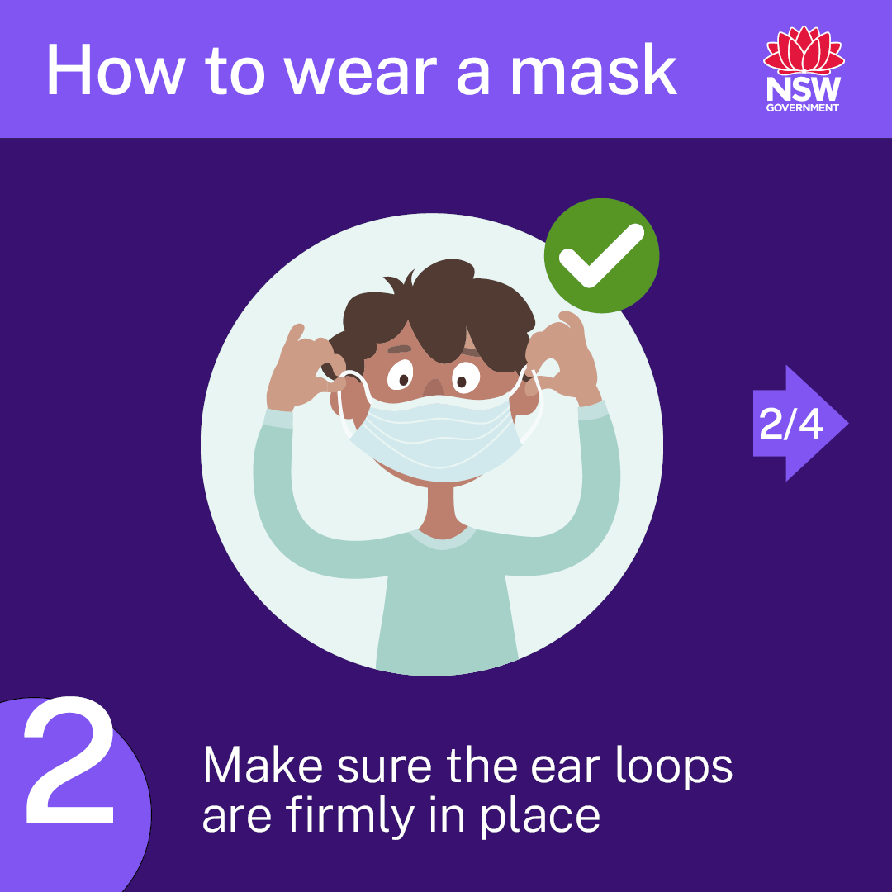
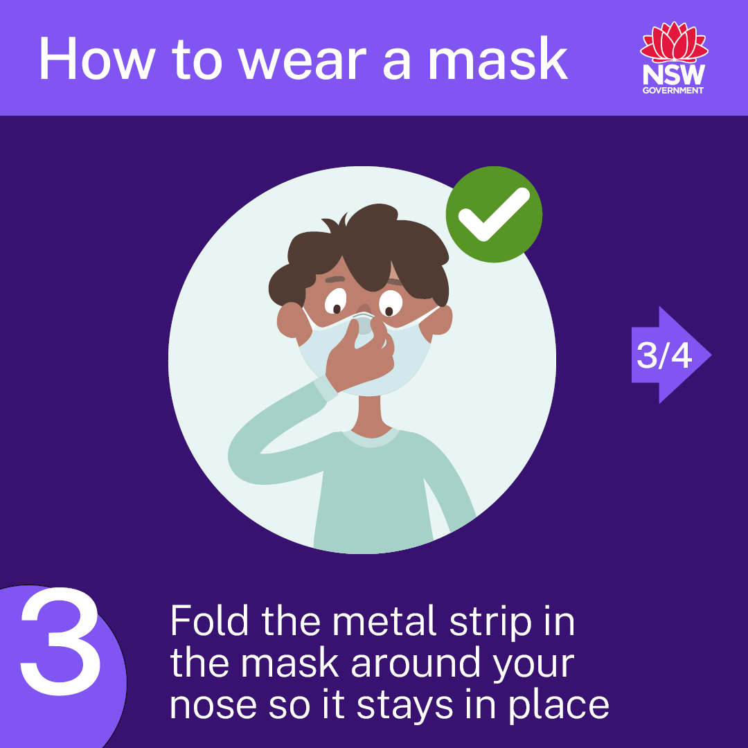
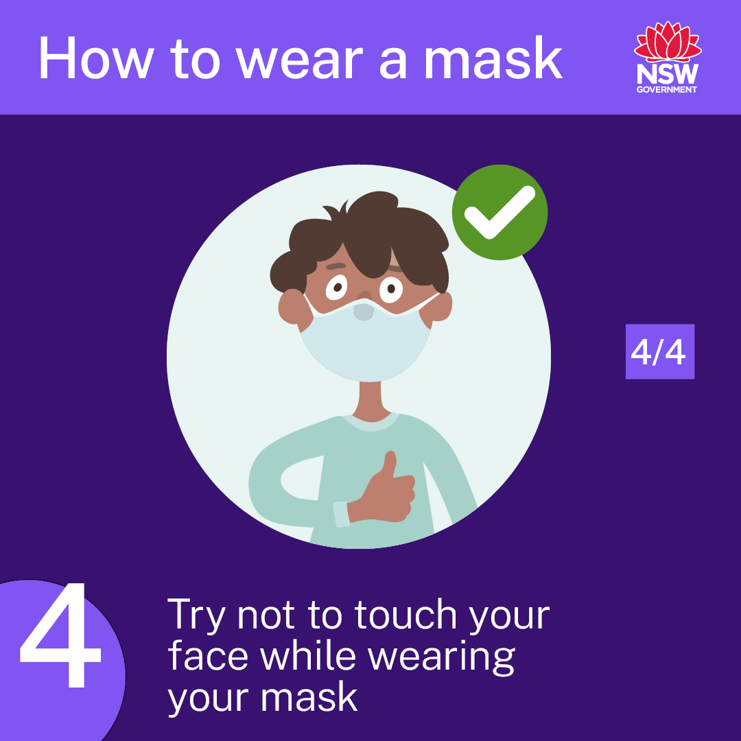
Fitting a mask to younger children
Notes:
This graphic has been provided by NSW Health. In the principal's toolkit are a range of posters, social media posts and resources you can use to support mask wearing on site and with your school communities.

Slide 11
Ventilation
Having open or well-ventilated spaces reduces the risk of transmission of COVID-19 because infectious particles are more quickly diffused in the open air. The department will continue to work with NSW Health to provide us with advice and guidance on maintaining good ventilation in our school and we will make use of our outdoor spaces wherever practical.
At Cessnock East Public School we are lucky to have so many outdoor learning spaces. Our school has been inspected to make sure our windows open and our ceiling fans work.
Notes:
Ventilation
ACTION: Replace red text with school-relevant information about ventilation once your school has received your audit report (expected to land on 8 October to principals directly).

Slide 12
School activities
During Term 4 many school-based activities will remain on hold until NSW Health advise otherwise. This includes large celebrations like assemblies, presentation days and graduations, arts and sports events.
Unfortunately, school based programs such as Scripture and the Sports in School program will no longer run. We look forward to these programs returning in 2022.
Notes:
School activities
ACTION: Replace red text with school-relevant information about school activities.

Slide 13
Orientation and transition to school
Onsite orientations and transition programs are not currently allowed in person on school sites until we are advised differently by NSW Health. We’ll share more information in the coming weeks about our school’s virtual orientation and transition program.
At Cessnock East Public School we will begin with a virtual orientation program and hopefully, if the guidelines change, we will have our 2022 Kindergarten students on site later in Term 4. We will be in contact with families to explain how to this program will run.
Notes:
Orientation and transition
ACTION: Replace red text with school-relevant information about orientation and transition.

Slide 14
Preschool and outside of school hours care
Out of school hours care, vacation care settings and preschools operating on school sites will follow the same COVID-safe guidelines as public schools including the requirement to be fully vaccinated from 8 November.
The Hunter Mobile Preschool will be back on site from Monday 18th October. Staff from the preschool will be in touch with families to explain any changes that will occur.
Notes:
Preschool and out of hours care
ACTION: Delete page if not relevant to your school setting. If relevant, replace red text with school-specific information.

Slide 15
Further information and questions
All of our students are expected to be back at school for their staggered return dates. After this date we will only be supporting learning from home where this is required by NSW Health to do so.
Parents and students will be notified if a decision is made to close the school due to a confirmed case of COVID-19. During this time we will continue to provide learning from home activities and we will let you know when we can return to face-to-face learning through updates on Skoolbag and Sentral.
Find updated information on the department's Advice for families page to support students who are anxious about the return to school – or get in touch with us directly.
https://education.nsw.gov.au/covid-19/advice-for-families
Notes:
[Insert school's COVID-safe measures to maintain student safety – reiterate hygiene practices and cleaning as well as the wellbeing and social benefits of students seeing their friends. Parents can refer to the wellbeing for students and families page https://education.nsw.gov.au/covid-19/wellbeing-for-students-and-families]

Slide 16
Thank you
Notes:
Final thank you slide
ACTION: Insert links to sources for further information (school website, Advice for families COVID-19 page (https://education.nsw.gov.au/covid-19/advice-for-families) and where they can go to get their questions answered.

